Slide 1

Creating a M-agical Date Table
Kristyna Ferris
Feel free to grab some swag up front!

Slide 2

About Me ~ Kristyna Ferris
Microsoft MVP, Data Platform & Fabric Solution Architect, P3 Adaptive Lexington Data Tech Group co-organizer Co-author on DataOnWheels
Blog - https://dataonwheels.wordpress.com/ LinkedIn - https://www.linkedin.com/in/kristyna-ferris-dataonwheels/
Twitter & Bluesky - @data_dragoness

Slide 3

Why do I need a Date Table?
Data navigation through time
Essential for DAX sorcery
Filtering precision
Foundational for answering business questions
Notes:
DAX Sorcery can be extremely simple using a date time.

Slide 4
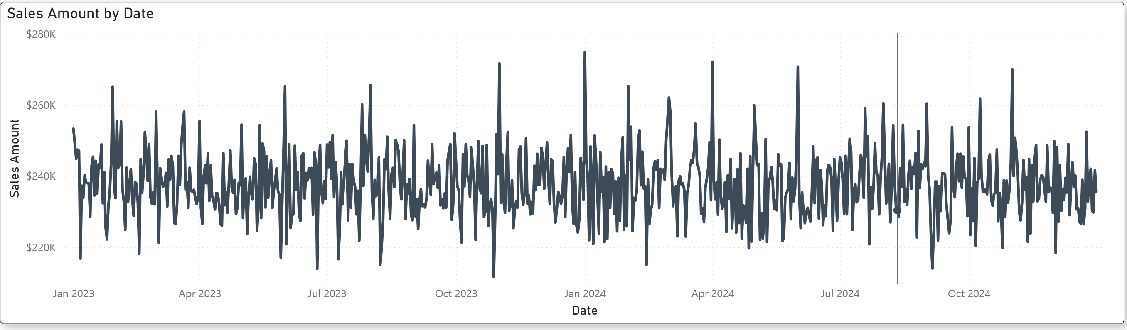
Visualizing Data Through Time
What questions can we answer using this chart? And what is unanswerable?
Notes:
What questions

Slide 5

What is M-Code?
Power Query’s scripting language
Performs transformation of data upon load for faster and more efficient visualization
Functional, not procedural (built step by step then compiled)
Editable in the Advanced Editor
Case-sensitive and…quirky
Notes:
ACID =

Slide 6
The “Quirks”
Must start with a "let" statement and end with an "in" statement
Every step must end with a comma except the last step
When using Table. functions, be sure to reference the previous step name as the table.
Not whitespace sensitive, but it is case sensitive.
Always name your steps, makes troubleshooting and updating a million times easier!
To avoid extra steps, assign data types when creating a column.
Follow the DRY philosophy - Don't Repeat Yourself. Use variables and columns to avoid having to redo logic
To remove columns, do so within power query. It’ll automatically fix the references in future steps
Notes:
ACID =

Slide 7

The “Quirks”
Notes:
ACID =

Slide 8
The “Quirks”
Must start with a "let" statement and end with an "in" statement
Every step must end with a comma except the last step
When using Table. functions, be sure to reference the previous step name as the table.
Not whitespace sensitive, but it is case sensitive.
Always name your steps, makes troubleshooting and updating a million times easier!
To avoid extra steps, assign data types when creating a column.
Follow the DRY philosophy - Don't Repeat Yourself. Use variables and columns to avoid having to redo logic
To remove columns, do so within power query. It’ll automatically fix the references in future steps
Notes:
ACID =

Slide 9
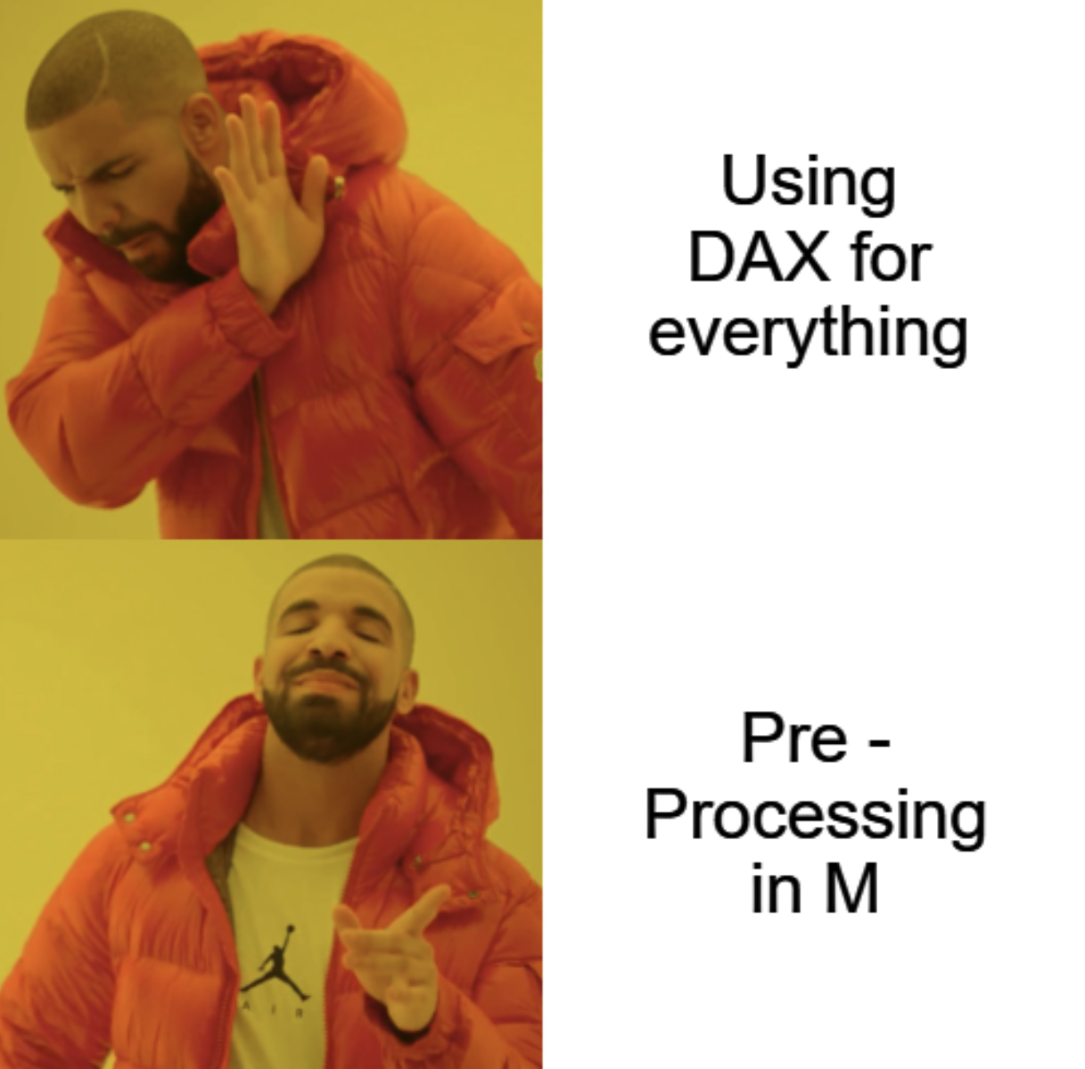
Why M-Code?
Performance Tuning (Roche’s Maxium)
Reusable Logic
Clean up dirty data without a full ETL pipeline
Do what DAX and SQL can’t
Conditional joins, dynamic column renames, file-level operations, etc.
Notes:
ACID =

Slide 10

Demo Time!

Slide 11

Don’t forget to connect, thanks for listening!
https://dataonwheels.wordpress.com/
kristyna@dataonwheels.com
@data_dragoness
GitHub

